Slide 1
Health Guard AI Detection System
Final Viva Presentation
D.G.C Minidu KADSE24.2F-004
W.A.S Soysa KADSE24.2F-002
K.M.H.K Bandara KADSE24.2F-049
Ravidu Wickramasinghe KADSE24.2F-041

Slide 2
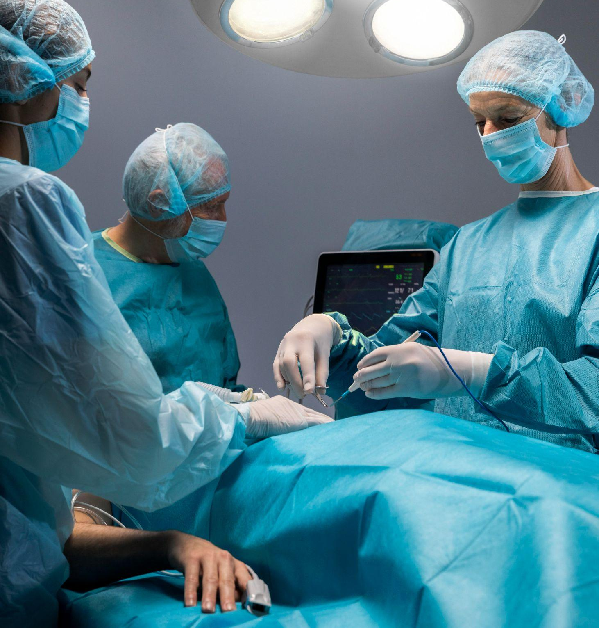
Introduction
Within the Rural areas of Sri Lanka, the most common diseases diagnosed include both communicable diseases such as dengue, leptospirosis, and tuberculosis, as well as non-communicable diseases like hypertension, diabetes, and heart diseases. In tea estate regions such as Thalawakelle, respiratory illnesses, maternal health issues, and malnutrition are also frequent. Liberty Channel Care Center situated within the suburbs of Thalawakelle district is a medical center witch usually offers attentive medical services to tea-estate workers with manual record checkups. Our project aims to assist healthcare staff in detecting early risks related to these conditions through AI-driven prediction

Slide 3
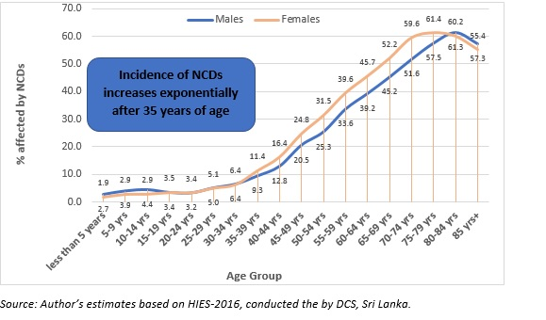
Problem Statement
Medical Records are kept manually as paper based records in Sri Lanka. Most of the health vitals are checked during the clinic visits to the health care centers. Most of the rural healthcare units bypass the continuous monitoring of BP and diabetes. Rural Hospitals in Sri Lanka lack Digital health Care Systems.

Slide 4
Objectives
01
02
03
04
Build ML model for risk prediction
User-friendly web/mobile app
Integration with wearables
Sckit-Learn
Flask-API
React.Js
Google Fit API
Support Remote Monitoring
Google Cloud

Slide 5
Proposed Solution
Web-App
Name: Shakya
Age: 25-35
Gender: female
Address: 125/4…
Systolic BP: 72
Diastolic BP: 109
Heart Rate: 72
SpO2: 60%
Notes: -------
Dashboard
Doctor

Slide 6
Methodolgy
01
02
03
Data Collection Methods : -
Manual Data Entry
Hospital & Clinic Databases
Agile Scrum process model for development : -
The Agile Software Development Model is adopted due to its flexibility and iterative nature
Software Development Tools : -
Programming Languages
✅ Python – Core language for machine learning.
✅ PHP – Backend development for handling web services and database operations.

Slide 7
System Architecture
Users
Front End
API (Application Programming Interface)
Machine Learning Model
Database
Cloud

Slide 8

UML Diagrams
ER Diagrams

Slide 9
Interfaces

Slide 10
Database Design

Slide 11
Testing Strategies
Unit Testing
ML Evaluation
Tests individual components such as the ML model, database operations, and API requests using PyTest.
1.Precison
2.Recall
Integration Testing
Ensures proper communication between frontend, backend, and database
Performance Testing
Evaluates system speed and load handling using JMeter

Slide 12
Implementation Plan
01
02
03
04
Requirement
Design
ML
Frontend/Backend
05
Device Integration
06
Testing
07
Deployment → Training

Slide 13
Key Features
Real-time prediction
Wearable integration
Doctor-patient collaboration
Reports & charts

Slide 14
Results & Impact
Logistic regression model implemented
User-friendly prototype tested
Preventive healthcare support

Slide 15
Conclusion
Project Goals Achieved
Developed ML model for health risk prediction
Built scalable, cloud-based system
Delivered user-friendly interfaces for patients and doctors
Preventive Healthcare with AI
Real-time monitoring and alerts
Early detection for rural communities
Reduced emergency hospital visits
Future Scope
Expand datasets for better accuracy
Integrate deep learning models
Add multilingual support for wider accessibility

Slide 16
Acknowledgement
Supervisor: Mr. Sandaruwan Herath
NIBM – School of Computing and Engineering
Liberty Channel Center – Thalawakelle
Tea estate community – Nuwara Eliya

Slide 17
Thank You
We welcome your Questions and Suggestions !

